Slide 1
Important Note Regarding This Microsoft PowerPoint Presentation
* Do not include this slide in your presentation *
This slide deck has been intentionally provided with very limited graphics and formatting to simplify content integration into your own preferred PowerPoint themes and styles.

Slide 2
Security Development Lifecycle (SDL) Field Content
Microsoft Compiler Defenses
(Level 300)

Slide 3
Agenda
Overview of the Microsoft SDL
Microsoft compiler defenses
/GS
/SAFESEH
/NXCOMPAT
/DYNAMICBASE
/robust
Microsoft SDL compiler defenses requirements and recommendations

Slide 4
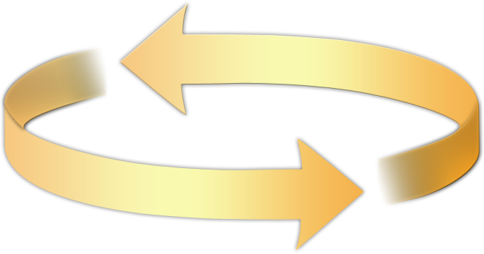
Microsoft Security Development Lifecycle (SDL)
Training
Requirem-ents
Design
Implemen-tation
Verification
Release
Response
Delivering secure software requires:
Executive commitment → SDL a mandatory policy at Microsoft since 2004
Education
Technology and Process
Accountability
Ongoing Process Improvements → 6 month cycle

Slide 5
Microsoft Compiler Defenses Overview
Microsoft Compiler Defenses: Run-time defense mechanisms that are applied to C/C++ applications compiled for Microsoft platforms.
Run-time defenses mostly from buffer overflows and other malicious attempts to control execution flow
Defensive code is automatically added by compiler, not developer
Compiler defenses do not fix security vulnerabilities
Should not be considered a “silver bullet”

Slide 6



Microsoft Compiler Defenses Illustrated
COMPILER &
LINKER
Source Code
Binary File

Slide 7
Buffer Security Checks (/GS)
Detects and prevents some buffer overflow attacks based on overwriting saved return addresses on the stack
Adds security cookies to protect critical memory data
Re-arranges stack frame to make buffer overflow exploitation much more difficult to achieve
Adds defenses for vulnerable arguments passed to a function
Enabled using the /GS compiler flag

Slide 8
Defending Return Addresses with Security Cookies
/* UNSAFE Function */
void UnsafeFunction(char * str)
{
char Buffer[32]; /* Copy str into Buffer */
strcpy(Buffer,str);
}
Input Into UnSafeFunction: “A” repeated 40 times
Stack Frame Without Security Cookies
Buffer (32 Bytes)
Address of Buffer
AAAA
AAAA
Saved Frame Pointer
Return Address
Function parameters
‘A’ repeated 32 times
Malicious Code

Slide 9
Defending Return Addresses with Security Cookies
/* UNSAFE Function */
void UnsafeFunction(char * str)
{
char Buffer[32]; /* Copy str into Buffer */
strcpy(Buffer,str);
}
Input Into UnSafeFunction: “A” repeated 40 times
Saved Security Cookie Value
Stack Frame With Security Cookies
Buffer (32 Bytes)
AAAA
AAAA
Random Security Cookie
Saved Frame Pointer
Return Address
Function parameters
‘A’ repeated 32 times

Slide 10
Buffer Security Check Demonstration

Slide 11
Buffer Security Check Limitations
Situations where buffer security checks are inapplicable / ineffective
Functions with no buffers
Functions marked with the “naked” attribute
Optimizations are not enabled
Functions with variable argument list
Functions that contain inline assembly in the first statement
Elements in a buffer are not 1 or 2 bytes, and is less than 5 bytes in size
Refer to http://msdn.microsoft.com/en-us/library/8dbf701c.aspx for more information

Slide 12
Safe Exception Handling (/SAFESEH)
Code that is called whenever an exception in code occurs
Address of handler is stored on stack and subject to corruption and hijacking
Code Red worm (MS01-033 Security Bulletin)
Enabled using the linker /SAFESEH flag
Refer to http://msdn.microsoft.com/en-us/library/9a89h429(VS.80).aspx for more information

Slide 13
Hardware-Enforced Data Execution Prevention (/NXCOMPAT)
Prevents code from executing in data pages
AMD: No eXecute (NX)
Intel: eXecute Disable (XD)
Microsoft: Data Execution Prevention (DEP)
Both processor and operating system must support this feature
Windows XP SP2 and higher supports this feature
Enabled using the linker /NXCOMPAT flag
Refer to http://msdn.microsoft.com/en-us/library/ms235442(VS.80).aspx for more information

Slide 14
Image Randomization (/DYNAMICBASE)
Indicates that applications should be randomly re-based at load time
Reduces the likelihood for success for buffer overflows by removing address predictability
Requires Data Execution Prevention to be enabled and operating system support
Enabled using the /DYNAMICBASE flag
Refer to http://msdn.microsoft.com/en-us/library/bb384887.aspx for more information

Slide 15
Image Randomization Illustration
0x12341234
0xEEEEFFFF
Address of Code to Execute
0xABCDABCD
0xBBBBCCCC
Buffer (N Bytes)
Address to Execute
AAAA
Saved Frame Pointer
Return Address
Function parameters
Malicious Code

Slide 16
Microsoft Interface Definition Language (MIDL) (/robust)
Relevant for remote procedure call (RPC) and Component Object Model (COM) code
Allows Network Data Representation (NDR) engine to perform run-time checking on arguments
Enabled using the MIDL compiler /robust flag
Refer to http://msdn.microsoft.com/en-us/library/aa367363(VS.85).aspx for more information

Slide 17
Microsoft SDL Compiler Defenses Windows 32-bit Requirements
Compiler Defense | Required | Recommended
/GS | ✓
/SAFESEH | ✓
/NXCOMPAT | ✓
/DYNAMICBASE |  | ✓
/robust | ✓
Minimum versions of compilers are also required by Microsoft SDL
See http://www.microsoft.com/sdl current guidance paper for more information

Slide 18
Conclusion
Overview of Microsoft compiler defenses
/GS
/SAFESEH
/NXCOMPAT
/DYNAMICBASE
/robust
Microsoft SDL compiler defenses requirements and recommendations

Slide 19
Appendix

Slide 20


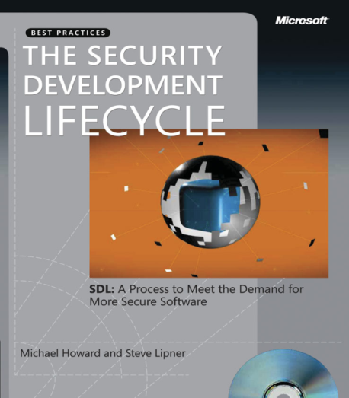


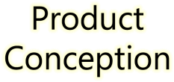
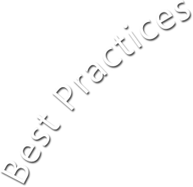




















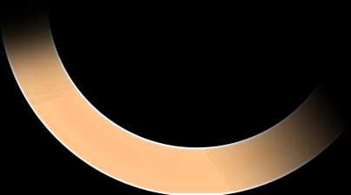

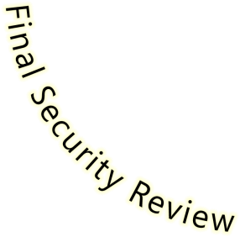


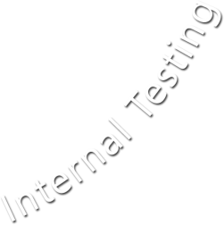





Microsoft Security Development Lifecycle (SDL)
SDL Book:
http://www.microsoft.com/mspress/books/8753.aspx
Official SDL Web Site: http://www.microsoft.com/sdl

Slide 21
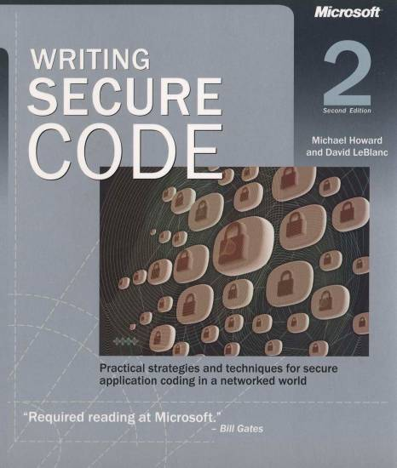
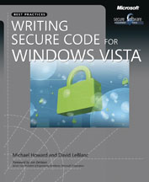
Microsoft Writing Secure Code Book Series
Writing Secure Code,
2nd Edition:
http://www.microsoft.com/mspress/books/5957.aspx
Writing Secure Code for Windows Vista:
http://www.microsoft.com/mspress/books/10723.aspx

Slide 22
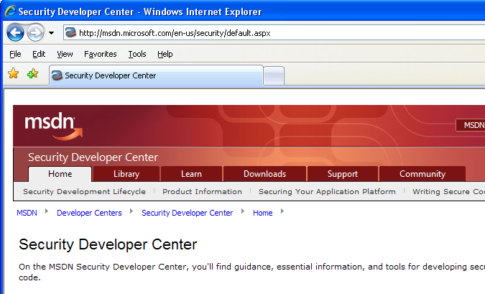

Microsoft Developer Network (MSDN) Security Developer Center
Official Web site: http://msdn.microsoft.com/security

Slide 23
Secure Development Blogs
The Microsoft Security Development Lifecycle (SDL) Blog: http://blogs.msdn.com/sdl
Michael Howard’s Blog: http://blogs.msdn.com/michael_howard

Slide 24
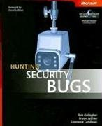
Microsoft Hunting Security Bugs
Hunting Security Bugs:
http://www.microsoft.com/mspress/books/8485.aspx

Slide 25
Additional SDL Training Content
Secure Design Principles
Secure Implementation Principles
Secure Verification Principles
SQL Injection Vulnerabilities
Cross-Site Scripting Vulnerabilities
Buffer Overflow Vulnerabilities

Slide 26
Microsoft Compiler Defenses Resources
/GS (Buffer Security Checks)
http://msdn.microsoft.com/en-us/library/8dbf701c.aspx
/SAFESEH (Safe Exception Handling)
http://msdn.microsoft.com/en-us/library/9a89h429.aspx
/NXCOMPAT (Data Execution Prevention)
http://msdn.microsoft.com/en-us/library/ms235442(VS.80).aspx
/DYNAMICBASE (Image Randomization)
http://msdn.microsoft.com/en-us/library/bb384887.aspx
/robust (MIDL Compiler)
http://msdn.microsoft.com/en-us/library/aa367363(VS.85).aspx

